Slide 1

Emotionally Intelligent Machines & Sentiment Sythesis based on Ancient Vedic Astrology
(June 03, 2023)
Seminar (MCS 291)
M.TECH CSE
Guided By:
Dr. Priyank Singhal
Mr. Vikas Kuchhal
Presented By:
Mohit Singh
TEERTHANKER MAHAVEER UNIVERSITY,
COLLEGE OF COMPUTING SCIENCES & INFORMATION TECHNOLOGY
MORADABAD-244001(INDIA)
Session: 2022-23

Slide 2
CONTENTS
ABSTRACT
INTRODUCTION
LITERATURE REVIEW
REFERENCES
June 03, 2023

Slide 3
ABSTRACT
In this presentation, we will discuss about the Emotionally Intelligent Machines(EIM's) which is the new field of research in Artificial Intelligence but it has a great potential to do immense good, however the technology can be misused but it is up to the consumers of this technology who will decide whether it will be used for good or for evil. Also, Astrology has always been a controversial topic and is completely depends upto the personal faiths and beliefs of an individual. Apart from that, we describe that how Emotionally Intelligent Machines(EIM's) & Sentiment Synthesis Systems can be developed by using the concept of Ancient Vedic Astrology.
June 03, 2023

Slide 4
INTRODUCTION
We describes new research that is giving machines skills of emotional intelligence.
Machines have long been able to appear as if they have emotional feelings, but they are now being programmed to also learn when and how to display emotion in ways that enable them to appear empathetic or otherwise emotionally intelligent. They are now being given the ability to sense and recognize expressions of human emotion such as interest, distress, and pleasure, with the recognition that such communication is vital for helping them choose more helpful and less aggravating behaviour.
June 03, 2023

Slide 5
INTRODUCTION
Emotionally Intelligent Machines are the systems that can recognize, interpret, process, and simulate human emotions which could be based on the concept of the ancient vedic astrology. They are the machines which can adapt different situations and knows how to handle these situations more intelligently and smartly.
This seminar also highlights different aspects of emotional behaviour of human beings.
June 03, 2023

Slide 6
LITERATURE REVIEW
Why Truly Intelligent Machines Need Emotions?
After brain researchers have recognized that emotions are crucial for human and animal intelligence, Artificial Intelligence researchers have also started to acknowledge the importance of emotions in the design of intelligent machines. In modern technical world, the need of EIM's are can be seen due to their numerous applications which are expanding rapidly.
June 03, 2023

Slide 7
LITERATURE REVIEW
Some of the common applications of EIM's are:
Social Media: EIM's can be used in social media to analyse user's emotions and provide more personalized content.
Operational Research & Business Intelligence: EIM's are more intelligent than the traditional machines as a result they can be used in Business Intelligence and can help in Decision Making.
Human Resources: EIM's can be used in human resources to analyse employee's emotions and improve the work environment and productivity.
June 03, 2023

Slide 8
LITERATURE REVIEW
Development of Machine Ethics & Computational Morality: EIM's can be useful in developing machine ethics and morality by allowing machines to understand and respond to human emotions, which is an important component of ethical and moral decision-making.
Human-Computer Interaction(HCI): EIM's is extremely helpful in HCI, as it enables computers to understand and respond to human emotions, making the interaction more natural, intuitive, and empathetic.
June 03, 2023

Slide 9
LITERATURE REVIEW
Customer Service: EIM's can be used in customer service to understand customer’s emotions and respond accordingly, improving customer satisfaction. They can also be used in getting customer reviews, feedbacks & and conducting surveys.
Healthcare: EIM's can be used in healthcare to detect patient's emotions and provide appropriate treatment and care. Treatment of psychic patients. Counselling for persons suffering form depression & anxiety or even having suicidal tendency.
June 03, 2023

Slide 10
LITERATURE REVIEW
Education: EIM's can be used in education sector to improve the effectiveness of teaching by understanding the emotional state of the students and adapting the teaching method accordingly.
Marketing & Sales: EIM's can be used in marketing to analyse customer's emotions and tailor marketing messages to maximize their impact.
June 03, 2023

Slide 11
LITERATURE REVIEW
Art & Culture: Artistic content generation such as Melodies & Progressions in Music, Paintings & Poetry with correspondence to the culture.
Entertainment: EIM's can be used in the entertainment industry to create more immersive experiences for users by understanding their emotional responses, in gaming & movies industries to create more engaging games that respond to the player's emotions also to create the dynamic environments accordingly and writing scripts.
June 03, 2023

Slide 12
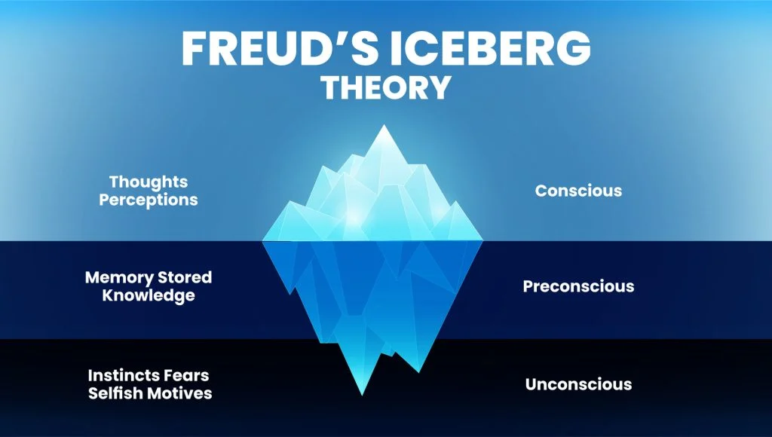
LITERATURE REVIEW
Cognitive Psychology
June 03, 2023

Slide 13
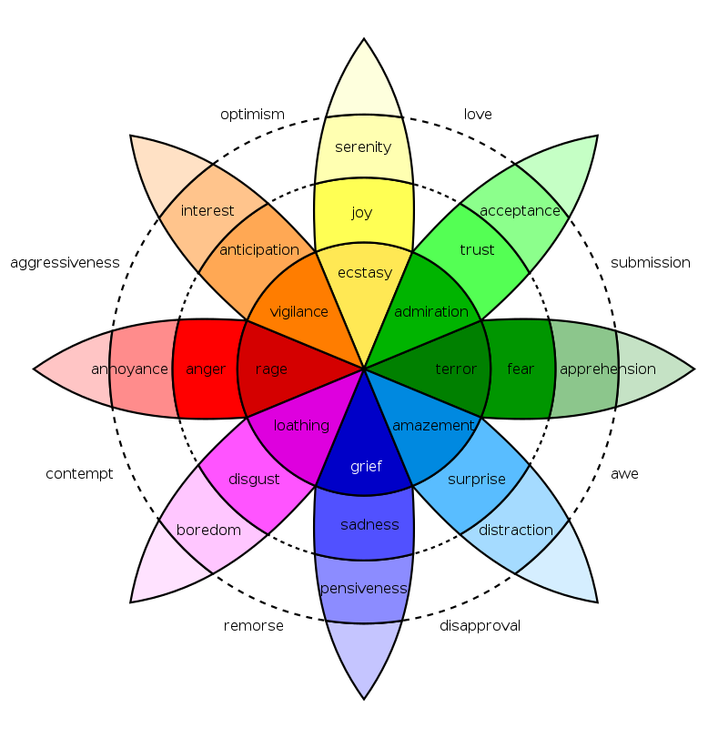
LITERATURE REVIEW
Plutchik’s Wheel of Emotions
June 03, 2023

Slide 14
LITERATURE REVIEW
Convergence, Divergence & Belief Systems
Belief system is a topic on which the more we talk, the less the words. This is what’s the only reason due to which similarities and differences exists between the thoughts and mentalities of different people. This is what is responsible for influencing, changing, and strengthening our emotions. Believing in something is called a belief system, and not believing in something is also a belief system in itself.
June 03, 2023

Slide 15
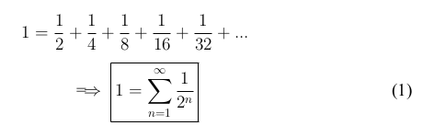
LITERATURE REVIEW
Convergence, Divergence & Belief Systems
June 03, 2023

Slide 16
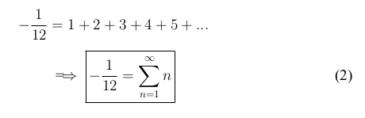
LITERATURE REVIEW
Convergence, Divergence & Belief Systems
June 03, 2023

Slide 17
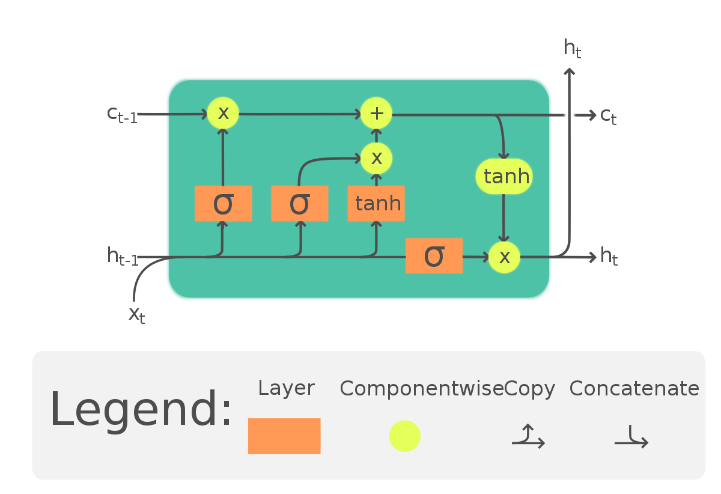
LITERATURE REVIEW
LSTM-RNN
June 03, 2023

Slide 18
LITERATURE REVIEW
Logical Thinking vs Intuition
Logic and intuition are two different ways of acquiring knowledge and making decisions.
Logic is a systematic and rational way of thinking that relies on rules, principles, and evidence to arrive at a conclusion. It involves reasoning and analysis, and is based on the assumption that true knowledge can be acquired through objective observation and testing. Logical thinking is often associated with science, mathematics, and philosophy, and is used to solve problems and make decisions in a wide range of fields.
June 03, 2023

Slide 19
LITERATURE REVIEW
Logical Thinking vs Intuition
Intuition, on the other hand, is a more subjective and immediate way of knowing that is based on a person's instinct or "gut feeling" about a situation. It is often described as a kind of unconscious or automatic mental process that occurs without conscious awareness or reasoning. Intuitive thinking is associated with creativity, innovation, and quick decision-making, and is often used in fields such as art, design, and entrepreneurship.
June 03, 2023

Slide 20
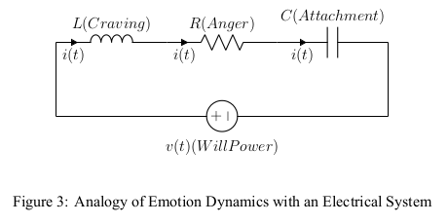
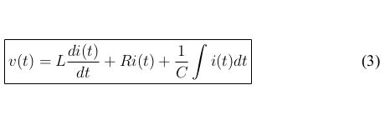
LITERATURE REVIEW
Emotion Dynamics
June 03, 2023

Slide 21
LITERATURE REVIEW
Vedic Astrology on Emotions
Astrology is like the snapshot of our unconscious mind.
The origins of Vedic astrology can be traced back to around 1500 BCE, during the late Vedic period. It is classified into the three major branches or disciplines known as the Siddhanta, Samhita and Hora. These branches provide different approaches and methods for studying and practicing astrology.
June 03, 2023

Slide 22
LITERATURE REVIEW
Properties of Planets
Sun (Surya): The Sun represents the self, vitality, authority, and leadership. It symbolizes the soul and is considered the king among the planets.
Moon (Chandra): The Moon represents emotions, mind, instincts, and nurturing qualities. It influences the individual's emotional well-being and intuition.
Mercury (Budha): Mercury is associated with communication, intellect, logic, and adaptability. It governs speech, learning, and mental abilities.
June 03, 2023

Slide 23
LITERATURE REVIEW
Properties of Planets
Venus (Shukra): Venus is the planet of love, beauty, art, and harmony. It governs relationships, attraction, creativity, and material pleasures.
Mars (Mangal): Mars signifies energy, passion, courage, and assertion. It governs ambition, drive, physical strength, and competitiveness.
Jupiter (Guru): Jupiter is considered the most benefic planet in Vedic astrology. It represents wisdom, knowledge, expansion, abundance, and spirituality.
June 03, 2023

Slide 24
LITERATURE REVIEW
Properties of Planets
Saturn (Shani): Saturn is associated with discipline, responsibility, hard work, and karmic lessons. It teaches patience, endurance, and signifies limitations and life challenges.
Rahu: Rahu is a shadow planet and represents material desires, obsession, illusions, and worldly attachments. It signifies ambition and can bring sudden changes.
Ketu: Ketu is the other shadow planet and represents spirituality, detachment, mysticism, and karmic lessons. It signifies liberation and can bring unconventional experiences.
June 03, 2023

Slide 25
LITERATURE REVIEW
S.NO | PAPER TITLE | TECHNIQUES | FINDINGS | YEAR
1 | Concise History of Hindu Astrology | - | Overview of Rashi, Navagrahas and Dashas | 2023
2 | The Unconscious and Planetary Influences | - | Planetary Influences on Human Physiology and Psychology | 2023
3 | Astrology, Modernity & Self Identity | - | Application of Astrology in getting Self- Knowledge | 2020

Slide 26
LITERATURE REVIEW
S.NO | PAPER TITLE | TECHNIQUES | FINDINGS | YEAR
4 | Predictability and Predictions | Nonlinear, Baroclinic, 3D Model of the Tropical Cyclone | Effects of Initial Conditions on Numerical Instabilities | 2022
5 | 3 Butterfly Effects in Lorenz Models | Classical Lorenz Model | Sensitive Dep. of Sol. of Non-Linear Diff. Eq. on Initial Cond. | 2022
6 | RL for Text-to-Speech Synthesis & Sentiment Synthesis | Interactive training paradigm for Emotional TTS Synthesis (i-ETTS) | Use of Reinforcement Learning in Sentiment Synthesis | 2021

Slide 27
LITERATURE REVIEW
S.NO | PAPER TITLE | TECHNIQUES | FINDINGS | YEAR
7 | Emotional Speech Syn. in a News System | Combination of BERT and BiLSTM-CRF | Need and Application of Sent. Synthesis | 2020
8 | Sentiment Analysis Based on DL | DNN, CNN, RNN and TF-IDF | Application of DL Tech. on Sent. Analysis | 2020
9 | GAN’s in Emotion Synthesis | GANs | Working of GAN and Sent. Sythesis using it | 2020

Slide 28
LITERATURE REVIEW
S.NO | PAPER TITLE | TECHNIQUES | FINDINGS | YEAR
10 | Summarizing Emotions from Text By Plutchik's | Psychological Model of Human Sent. | Sentiment Analysis using Plutchik’s Wheel of Emotions | 2019
11 | Emotional Intelligence in Artificial Intelligence | - | Role of EI in AI and its Potential Applications | 2019
12 | Consciousness and Unconsciousness of AI | - | Problem of Multilevel Mind in Artificial Intelligence Systems | 2019

Slide 29
LITERATURE REVIEW
S.NO | PAPER TITLE | TECHNIQUES | FINDINGS | YEAR
13 | Word-level sentiment analysis with | LSTM(WS-LSTM) Model | Application of LSTMs in Sentiment Analysis | 2019
14 | Sentiment Intensity Ranking among Adjectives | Semi-Supervised Technique | Sent. Specific Word Embeddings (SSWE) are better than word2vec and GloVe | 2017
15 | Emotional Chatting Machine | Gated Recurrent Unit(GRU) | Model can Generate Emotions as Responses | 2017

Slide 30
LITERATURE REVIEW
S.NO | PAPER TITLE | TECHNIQUES | FINDINGS | YEAR
16 | Long Short-term Memory | - | Introduction to LSTM-RNN | 1997
17 | Surya Siddhanta | Ancient Mathematical Tech. for Calc. of Astronomical Phenomena | Timings, Dashas and Transits in Vedic Astrology | 2018
18 | Brihat Parashara Hora Shastra | - | Guidelines and Principles for Analyzing a Person's Traits, Strengths, Weaknesses | 2023

Slide 31
LITERATURE REVIEW
S.NO | PAPER TITLE | TECHNIQUES | FINDINGS | YEAR
19 | Geometric Series | Convergence | Relation of Convergence with Human Beliefs | 2022
20 | Ramanujan summation | Divergence | Relation of Divergence with Human Beliefs | 2023
21 | Robert Plutchik | Modelling of Human Emotions on the Basis of Psychology | Relationship Between Different Kinds of Human Emotions | 2023

Slide 32
LITERATURE REVIEW
S.NO | PAPER TITLE | TECHNIQUES | FINDINGS | YEAR
22 | Emotion Dynamics | Modelling of Human Emotions on the Basis of Analogy | Analogy of Human Mind with an Electrical Dynamical System | 2017
23 | Understanding Conjunction in Vedic Astrology | - | Analogy of Electrical Concepts with Vedic Astrology | 2023

Slide 33
REFERENCES
Paulo Martins “A Concise History of Hindu Astrology and Indian Spirituality” Scholars Journal of Arts, Humanities and Social Sciences.
Paul Clements | Goldsmiths College, University of London, London, UK “Astrology, modernity and the project of self-identity” Goldsmiths College, University of London, London, UK.
Richard A. Anthes “Predictability and Predictions” MDPI Journal.
Bo-Wen Shen, Roger A. Pielke, Xubin Zeng , Jialin Cui, Sara Faghih-Naini, Wei Paxson & Robert Atlas “Three Kinds of Butterfly Effects within Lorenz Models” MDPI Journal.
Rui Liu, Berrak Sisman & Haizhou Li “Reinforcement Learning for Emotional Text-to-Speech Synthesis with Improved Emotion Discriminability” INTERSPEECH.
June 03, 2023

Slide 34
REFERENCES
Rui Liu, Berrak Sisman & Haizhou Li “Reinforcement Learning for Emotional Text-to-Speech Synthesis with Improved Emotion Discriminability” INTERSPEECH.
Hiroaki Takatsu, Ryota Ando, Yoichi Matsuyama & Tetsunori Kobayashi “Sentiment Analysis for Emotional Speech Synthesis in a News Dialogue System” Proceedings of the 28th International Conference on Computational Linguistics.
Noushin Hajarolasvadi, Miguel Arjona Ramírez & Hasan Demirel “Generative Adversarial Networks in Human Emotion Synthesis:A Review” Noushin Hajarolasvadi et al.
Sahiti S. Magapu & Sashank Vaddiparty “The Study of Emotional Intelligence in Artificial Intelligence” International Journal of Innovative Science and Research Technology.
Ruiqi Chen, Yanquan Zhou, Liujie Zhang & Xiuyu Duan “Word-level sentiment analysis with reinforcement learning” IOP Conference Series: Materials Science and Engineering.
June 03, 2023

Slide 35
REFERENCES
Eugene Piletsky “Consciousness and Unconsciousness of Artificial Intelligence” Future Human Image, Volume 11, 2019.
Mohsin Manshad Abbasi & Anatoly Beltiukov “Summarizing Emotions from Text Using Plutchik’s Wheel of Emotions” Advances in Intelligent Systems Research, volume 166.
Arvind Kumar, Rajiv Singh & Ram Chandra “Emotional Intelligence for Artificial Intelligence: A Review” International Journal of Science and Research (IJSR).
Raksha Sharma, Arpan Somani, Lakshya Kumar & Pushpak Bhattacharyya “Sentiment Intensity Ranking among Adjectives Using Sentiment Bearing Word Embeddings” IIT Bombay, India.
June 03, 2023

Slide 36
REFERENCES
Hye-Rin Kim, Yeong-Seok Kim, Seon Joo Kim & In-Kwon Lee “Building Emotional Machines: Recognizing Image Emotions through Deep Neural Networks” PapersWithCode.
Hao Zhou, Minlie Huang, Tianyang Zhang, Xiaoyan Zhu & Bing Liu “Emotional Chatting Machine: Emotional Conversation Generation with Internal and External Memory” PapersWithCode.
June 03, 2023

